Slide 1
Design Patterns
{Dev}School
14.05.2019

Slide 2
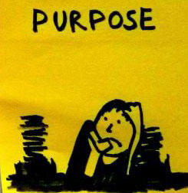
Contents
Observer
Strategy
Decorator
Factory
Singleton
Builder
Iterator
Adapter
Command

Slide 3
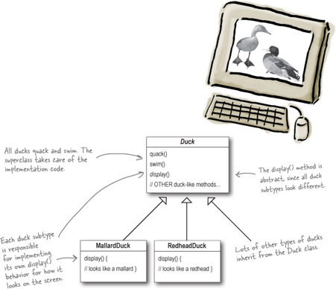
Duck Simulator App

Slide 4
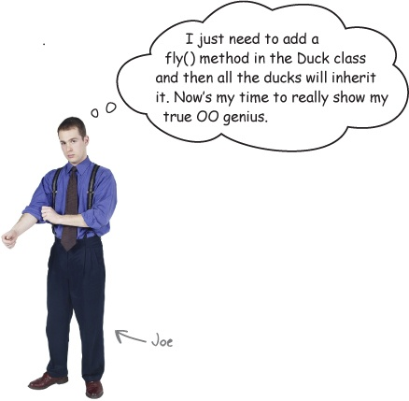
Duck Simulator App

Slide 5
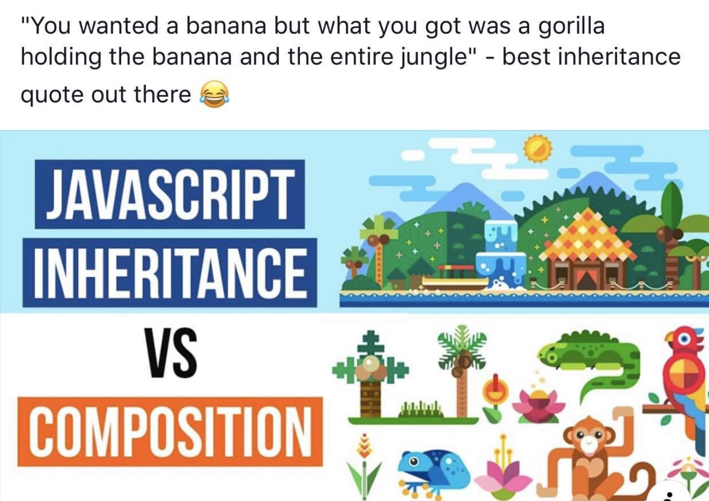

Slide 6
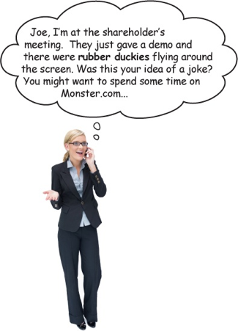
Duck Simulator App

Slide 7
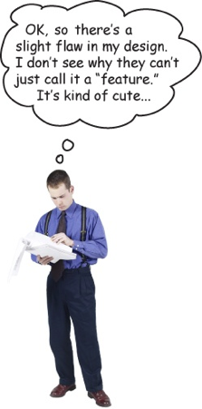
Duck Simulator App

Slide 8
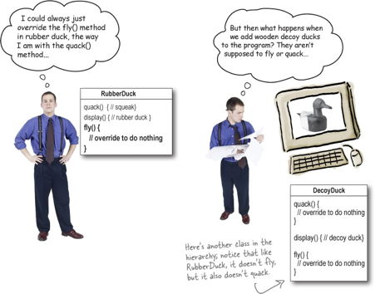
Duck Simulator App

Slide 9
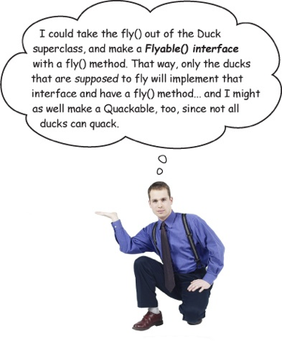
Duck Simulator App

Slide 10

Duck Simulator App

Slide 11
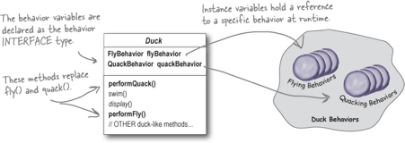
Duck Simulator App

Slide 12
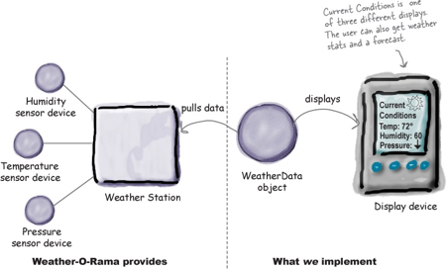
Weather Station

Slide 13
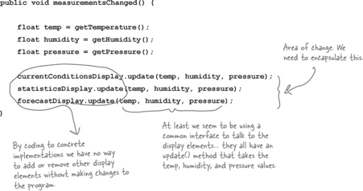
Weather Station

Slide 14
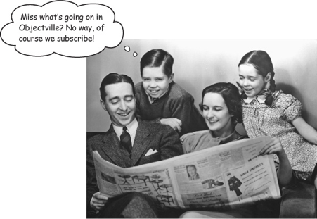
Weather Station

Slide 15
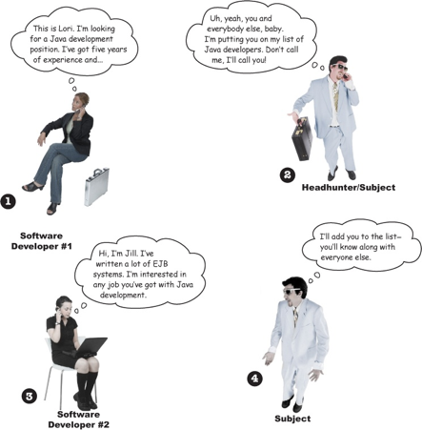
Weather Station

Slide 16
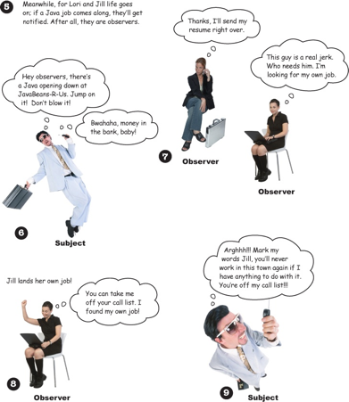
Weather Station

Slide 17
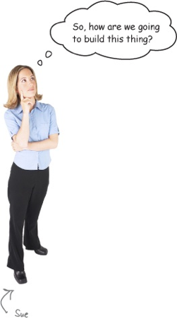
Weather Station

Slide 18
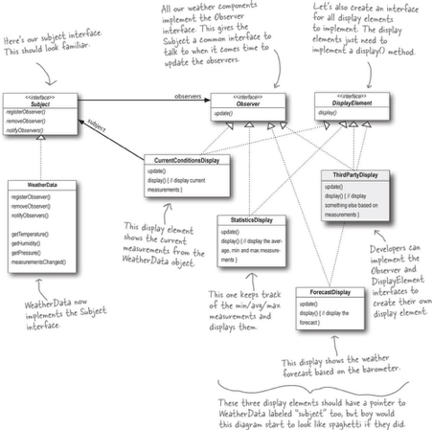
Weather Station

Slide 19
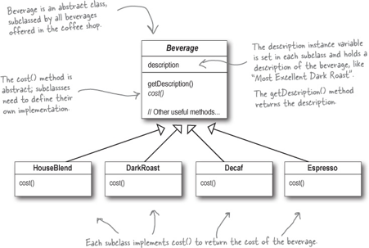
Starbucks
In addition to your coffee, you can also ask for several condiments like steamed milk, soy, and mocha (otherwise known as chocolate), and have it all topped off with whipped milk.

Slide 20
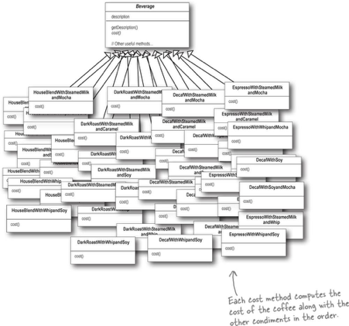
Starbucks

Slide 21

Starbucks

Slide 22

Starbucks

Slide 23
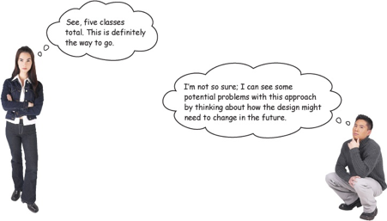
Starbucks

Slide 24
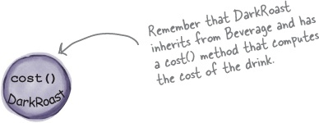
Starbucks

Slide 25
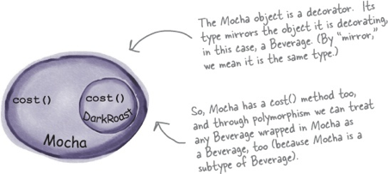
Starbucks

Slide 26
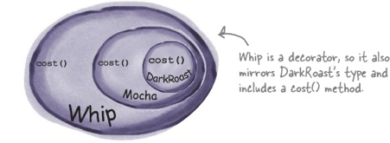
Starbucks

Slide 27
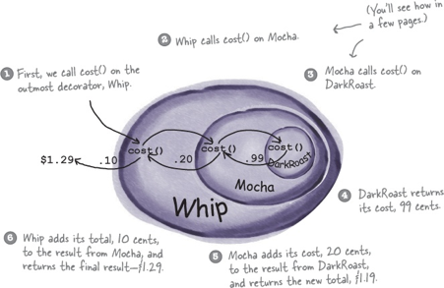
Starbucks

Slide 28
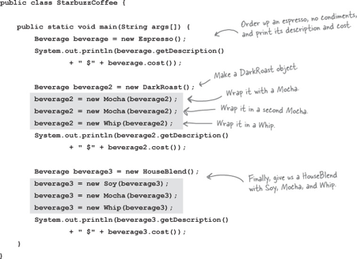
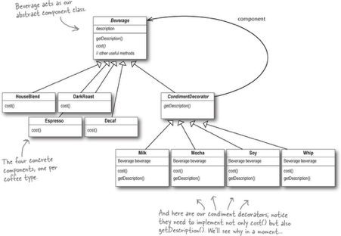
Starbucks

Slide 29
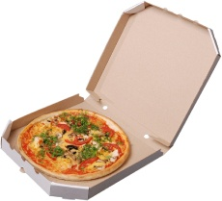
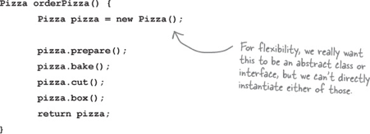
Pizza Store

Slide 30
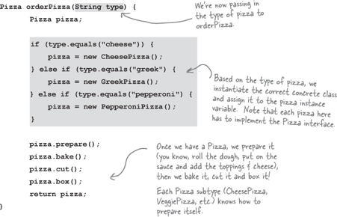
Pizza Store

Slide 31
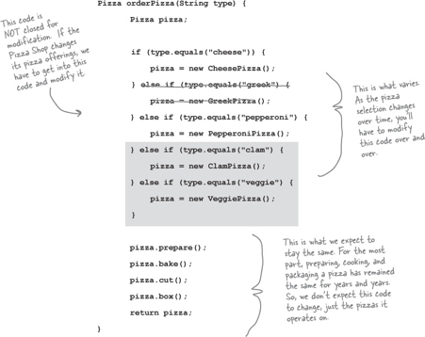
Pizza Store

Slide 32
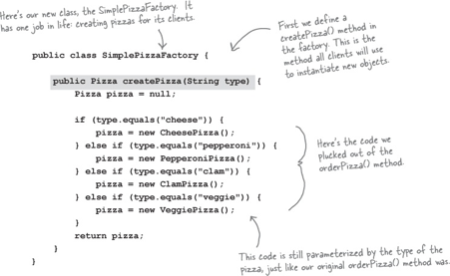
Pizza Store

Slide 33
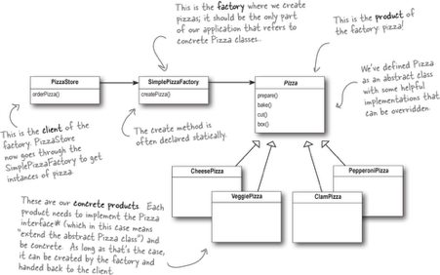
Pizza Store

Slide 34
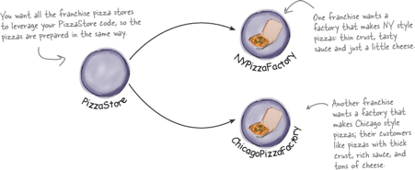
Pizza Store

Slide 35
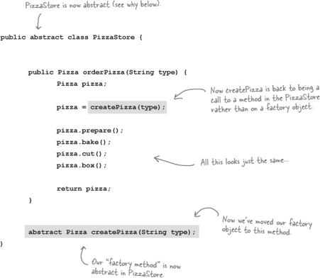
Pizza Store

Slide 36
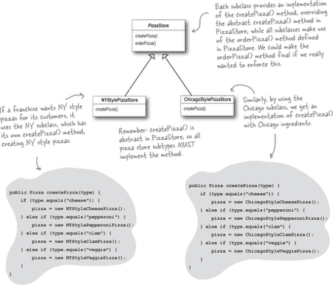
Pizza Store

Slide 37
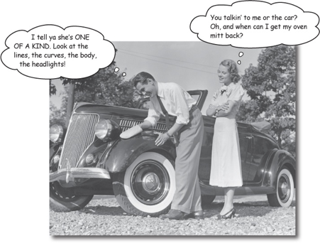
Singleton

Slide 38
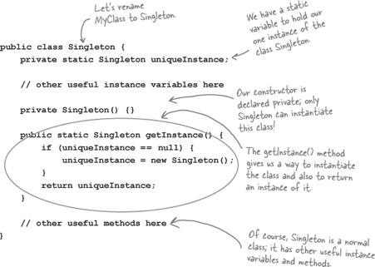
Singleton

Slide 39
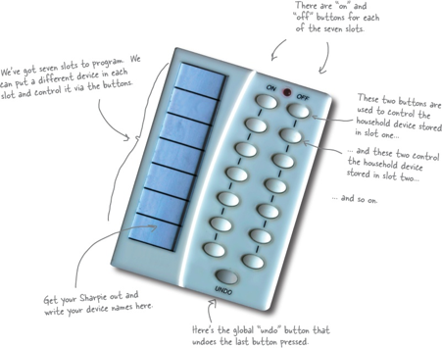
Remote control

Slide 40
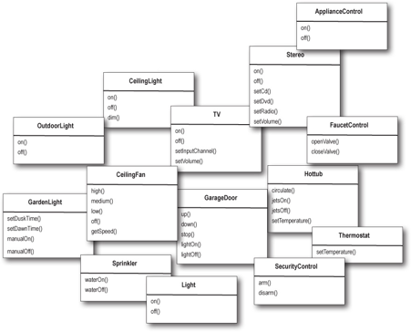
Remote control

Slide 41
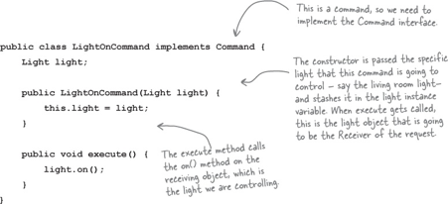
Remote control

Slide 42
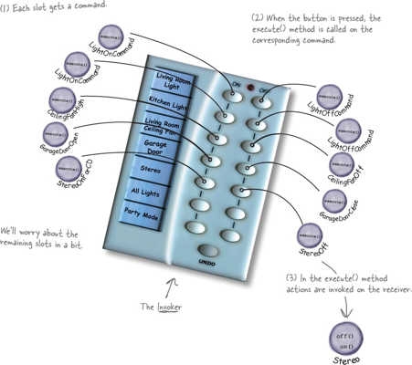
Remote control

Slide 43
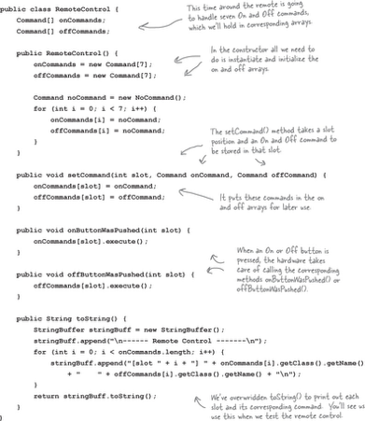
Remote control

Slide 44
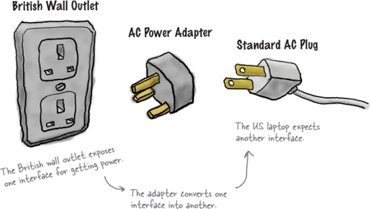
Adapter

Slide 45
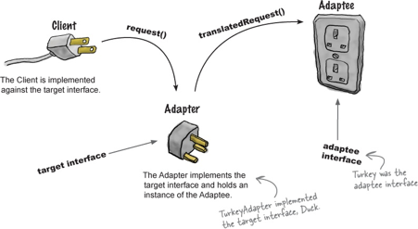
Adapter

Slide 46
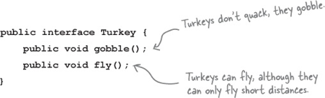
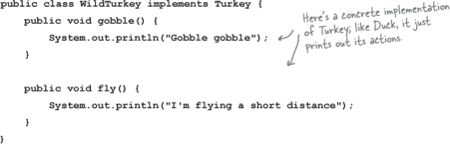
Adapter

Slide 47
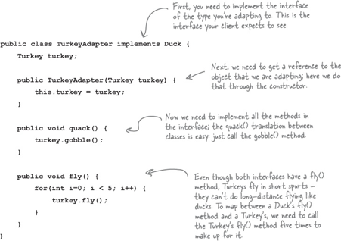
Adapter

Slide 49
Resources:
Head First Design Patterns by Kathy Sierra, Bert Bates, Elisabeth Robson, Eric Freeman

